Slide 1

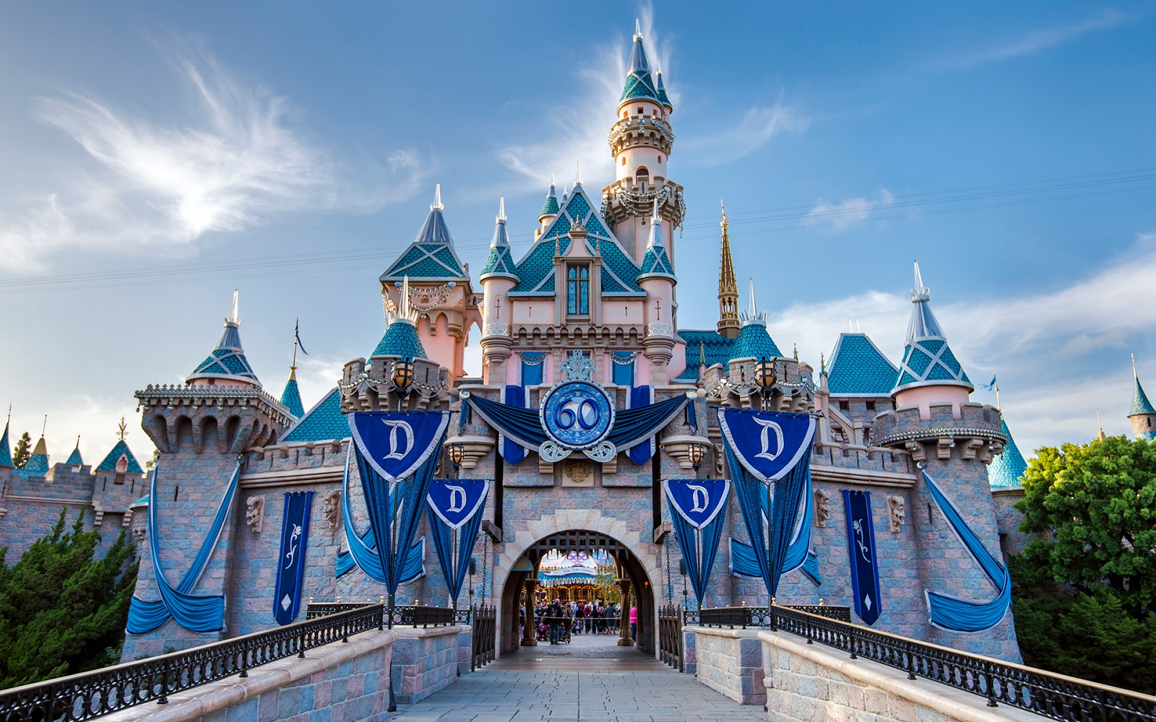
Statistical Analysis on- Disneyland: Footfall and net income
IE6200
Engineering Probability and Statistic SEC 01 Fall2016
Professor: Rajesh Jugulum
Members: Abhishek Thosar, Saish Pai, Sanket Kulkarni, Swenal Fargose

Slide 2
INTRODUCTION:
The Walt Disney company is a world leader in the entertainment and amusement park business. Although the amusement park business is expanding rapidly, there is room for improvement in the operational efficiency of Disney. This project aims to suggest a way to tackle the above problem.
OBJECTIVE:
To predict the footfall numbers of the Disneyland theme parks for the upcoming year.
Find how the footfall and net income are correlated.

Slide 3
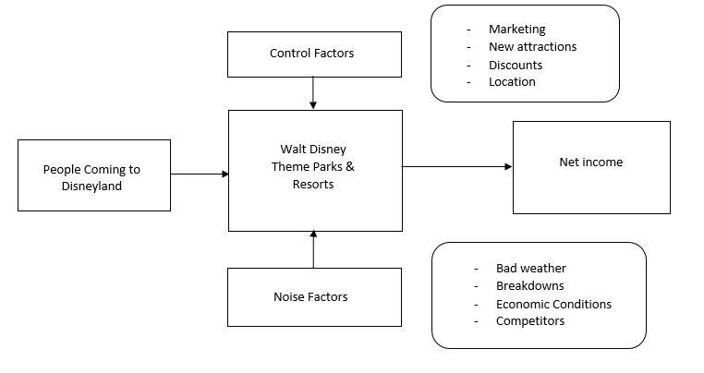
PARAMETER DIAGRAM

Slide 5
Box Plot of Florida and California Theme Parks

Slide 6
Descriptive Statistical Parameters of Footfall at California Parks
Anderson-Darling Normality Test
Variable | N | Mean | Std. dev. | 95% CI | T_{α/2, n-1}
California | 17 | 19.729 | 3.717 | (11.61, 27.89) | 2.110

Slide 7
Descriptive Statistical Parameters of Footfall at Florida Parks
Anderson-Darling Normality Test
Variable | N | Mean | Std. dev. | 95% CI | T_{α/2, n-1}
Florida | 17 | 47.694 | 5.014 | (36.76,58.63) | 2.110

Slide 8

Hypothesis Testing of Footfall data for 2015
Florida -
H_{o}: µ = μ₀ = 58.4 (In Million)
H_{a}: µ ≠ μ₀ Confidence interval (95%)
We calculate the t₀ and find,
t₀ = 2.075
Therefore, accept the null hypothesis.
California –
H₀: μ = μ₀ = 27.7 (In Million)
H_{a}: μ ≠ μ₀ Confidence interval (95%)
We calculate the t₀ and find,
t₀ = 2.084
Therefore, we accept the null hypothesis.
Prediction of footfall data for 2016
Florida $35.878 ≤Xn+1≤60.697$
California $11.395 ≤Xn+1≤28.948$
Notes:
Since the hypothesis tests are in congruence with our prediction intervals, therefore our prediction intervals for 2016 would be reasonably accurate.

Slide 9
Correlation between Footfall Data and Net income
Years | Net income | Total Footfall
1998 | 1446 | 84.2
1999 | 1620 | 86.3
2000 | 1586 | 85.7
2001 | 1169 | 94.4
2002 | 957 | 96.4
2003 | 1123 | 96.9
2004 | 1178 | 100.8
2005 | 1534 | 104.1
2006 | 1710 | 112.8
2007 | 1897 | 116.6
2008 | 1418 | 118
2009 | 1318 | 119.1
2010 | 1553 | 120.7
2011 | 1902 | 125
2012 | 2220 | 126.5
2013 | 2663 | 132.5
2014 | 3031 | 134.4
2015 | 3298 | 137.9
Correlation Coefficient = 0.7489631
This indicates how income and footfall are related and thus help business to focus over the primary income generating factors. The correlation between the two is found to be 74.90%.
Notes:
The critical element of any business decision is its financial aspect. Having calculated the prediction intervals of footfall data for the years 2015 and 2016, we need to understand the significance of this footfall data. For this purpose, we found the correlation between footfall data and net income of theme park business of Walt Disney Company.

Slide 10
Conclusions and Suggestions
The footfall future predictions will help you plan the business policies and allocation of resources.
74.9% correlation between footfall data and net income implies that the net income will increase with increase in footfall, but not all sources of income depend on the footfall alone.
The revenue for the business of theme parks and resorts is strongly correlated to the number of people visiting. But, as we see here, the correlation between footfall and net income is only moderately strong.
The expenses per footfall for Walt Disney can be reduced by attracting customers to avenues of income where the annual costs are less as compared to other sources of income.
Notes:
Revenue – Expenditure = Net Income
From the above equation we can say, the Net Income is adversely affected by the expenditure per footfall. In other words, the expenses per footfall are not in proportion with the revenue per footfall. The business strategy should especially concentrate on reducing the expenditure per footfall and in turn increase the net income.
Few other sources like annual fees from lease contracts, parking lots, food joints, annual passes, etc. contribute to the revenue independent of the footfall.
For example, customers should be more attracted to resorts, where the annual Operations and Maintenance costs are fairly marginal and constant as compared to that of amusement parks.

Slide 11
THANK YOU!

